Slide 1
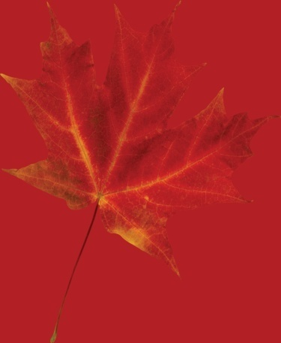
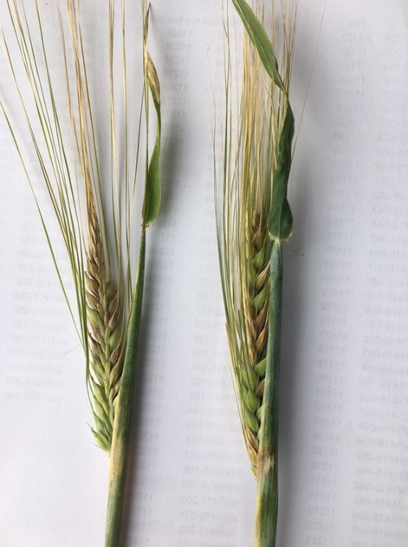
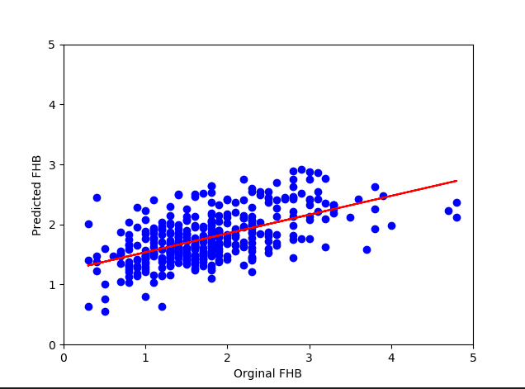
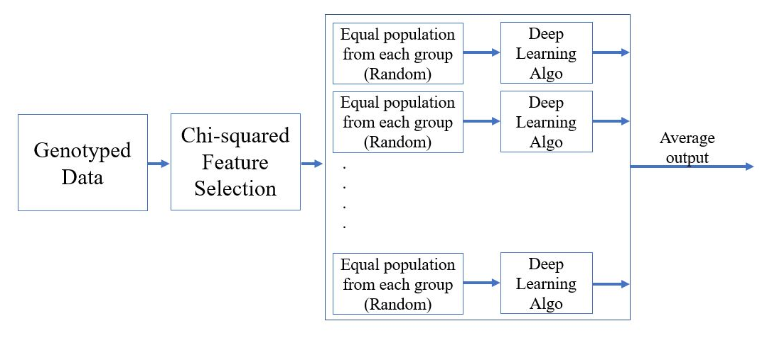


Agriculture and
Agri-Food Canada
Agriculture et
Agroalimentaire Canada
Genomic prediction of Fusarium head blight and deoxynivalenol content in two-row barley using deep learning methodologies
James R. Tucker^{1,3}*, Sheikh Jubair^{2*}, Ana Badea¹, Michael Domaratzki², and W.G. Dilantha Fernando³
¹Agriculture and Agri-Food Canada, Brandon Research and Development Centre, 2701 Grand Valley Road, P.O. Box 1000A, R.R. 3, Brandon, MB R7A 5Y3, Canada; ²Department of Computer Science, University of Manitoba, Winnipeg, MB R3T 2N2, Canada; ³Department of Plant Science, 222 Agriculture Building, University of Manitoba, Winnipeg, MB R3T 2N2, Canada
*Correspondence to: james.tucker@canada.ca; jubairs@myumanitoba.ca
Introduction
Results
Fusarium head blight (FHB), caused by Fusarium graminearum, is the most destructive disease of barley in Canada largely due to production of the mycotoxin deoxynivalenol (DON).
DON survives brewing process and has been found in Canadian and European beers (Scott et al. 1996)
The DCNN model obtained 0.717 and 0.593 in correlation respectively for predicting FHB and DON from genotyped data
These models also performed well to identify top individuals as the ndcg@10 for FHB is 0.515 and DON is 0.864
DON levels > 0.5 PPM will normally be rejected for malting purposes (BMBRI, 2010) resulting in premium loss to the producer
Next Generation Sequencing (NGS) and designer SNP array gene chips, provide plant breeders with modern tools to breed quantitative traits like FHB and DON through genomic selection (Crossa et al. 2017)
Models based on deep learning may offer an alternative to statistical methods and may be a useful predictive tool for genomic prediction (Pérez-Enciso and Zingaretti, 2019)
Figure 1. FHB symptoms in two-row (left) and six-row barley (right). Two-row barley is considered to be more resistant where infection of triplets (all three florets of a spikelet) are common in six-row barley
Material and methods
Figure 3. Correlational relationship between FHB score predicted from genotype and training population (original FHB) based on 20:80 random group assignment
A panel of 400 entries (n=2 reps) were evaluated in three FHB nurseries in Manitoba (Brandon, Carberry, Carman) over two years
Characters recorded: Days to heading, height, FHB (0-5 scale) and DON content (ELISA, Neogen Veratox 5/5)
Genotyped at AAFC-Morden (Dr. Colin Heibert) with an iSelect 50K SNP beadarray
Data were filtered for MFA < 5% and missing data > 20%, Imputation via TASSEL v5
Chi-square feature selection, a ranking approach used to identify the important markers
Implemented an ensemble deep DCNN for predicting FHB and DON where each DCNN contains 25 layers
The input of each DCNN is a subset of markers from important markers and the output is the average of predicted phenotypes of all DCNN models
DCNNs - a CNN block consists of a convolution layer, a rectified linear unit (ReLU), and a max pool and a dropout layer
Conclusions
Prediction of FHB and DON was possible using deep learning methods, which demonstrated some improvement over statistical methods
It is anticipated that this approach will assist BRDC breeding program in selecting elite material with FHB resistance
References
BMBRI, 2010. http://bmbri.ca/wp-content/uploads/2016/10/Quality-Factors-in-Malting-Barley-May-2010.pdf
Crossa et al. 2017. Trends Plant Sci. 22: 961-975. doi: 10.1016/j.tplants.2017.08.011
Scott et al. 1996. Journal of AOAC Int. 79: 875-882. doi: 10.1093/jaoac/79.4.69A
Pérez-Enciso and Zingaretti. 2019. Genes, 10, 553. doi:10.3390/genes10070553
Acknowledgements
Funding provided by Manitoba Wheat and Barley Growers Association, ARDI MB Government, Brewing and Malting Barley Research Institute, and Western Grains Research Foundation
Technical assistance: Kevin Moore, Roger Larios, AAFC-BRDC wheat breeding group, Mira Popovic
Figure 2. Workflow for deep learning procedure

